Slide 1
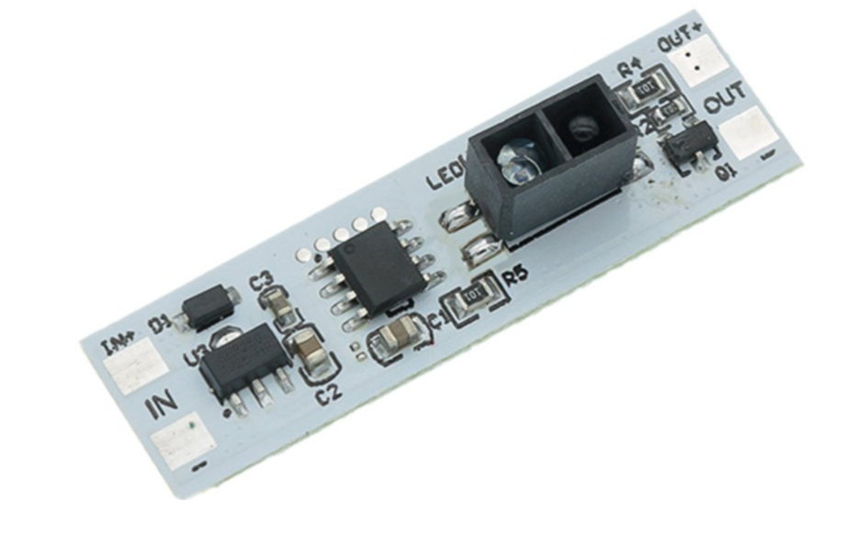
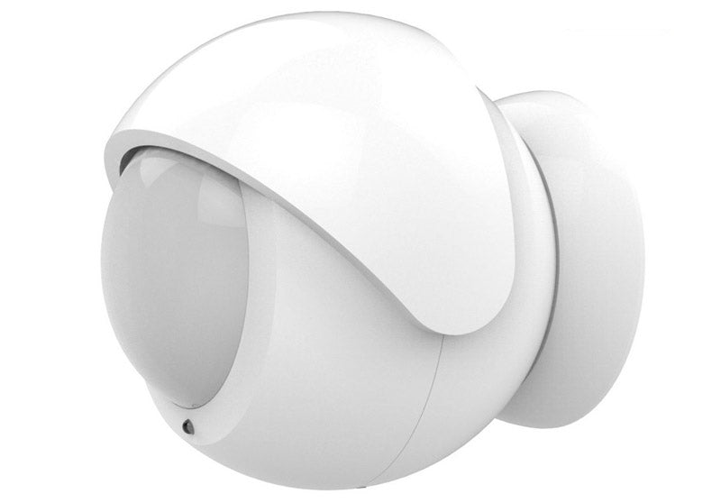
Introduction to PIR Sensors
Passive Infrared (PIR) sensors are electronic devices that detect the presence of infrared radiation emitted by living beings and objects.
These sensors are commonly used in security systems, automatic lighting, and energy conservation.

Slide 2
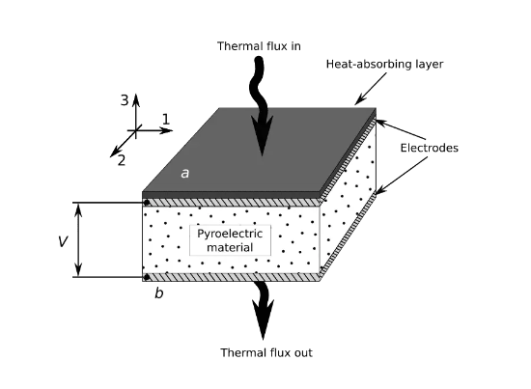
Introduction to PIR Sensors
The basic function of a PIR sensor is to detect changes in temperature caused by the movement of an object within its field of view.
This is achieved through the use of a pyroelectric material, which generates electrical signals when exposed to infrared radiation.

Slide 3
How PIR Sensors Work
PIR sensors work by detecting changes in the amount of infrared radiation emitted by objects within their field of view.
They are programmed to work at relatively short distances otherwise they will constantly be active.
They are designed to detect only the radiation emitted by moving objects and living beings such as humans and animals and not by stationary objects like furniture or walls.
Sensor

Slide 4
How PIR Sensors Work
When an object moves within the field of view of a PIR sensor, the sensor detects the change in temperature caused by the movement and converts it into an electrical signal. This signal is then processed by the sensor's circuitry to trigger an alarm or activate a device.

Slide 5
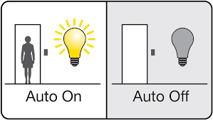
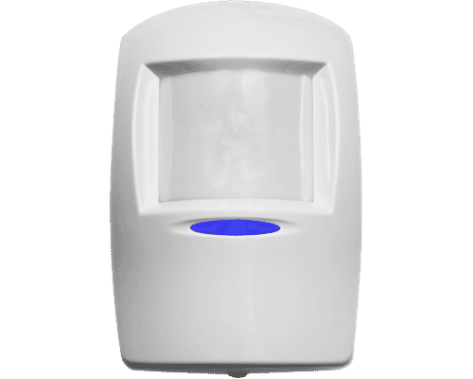
Applications of PIR Sensors
PIR sensors have a wide range of applications, including security systems, automatic lighting and energy conservation.
In security systems, PIR sensors are used to detect intruders and trigger alarms.
In automatic lighting systems, they are used to turn lights on and off based on the presence or absence of people in a room.
In energy conservation systems, they are used to control heating and cooling systems based on occupancy levels.

Slide 6
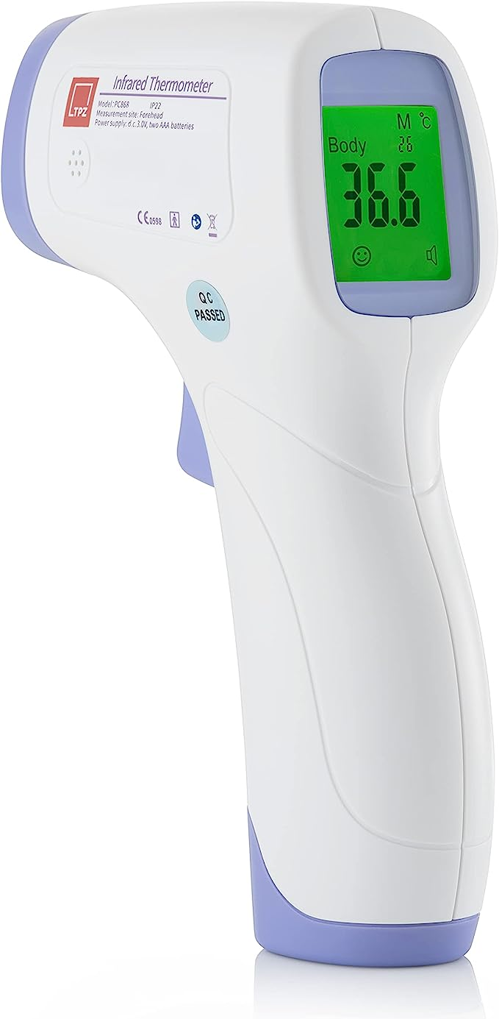
Applications of PIR Sensors
PIR sensors are also used in medical devices, such as fever scanners, and in automotive safety systems, such as collision avoidance systems. They are a versatile and cost-effective solution for a variety of sensing applications.

Slide 7
Advantages of PIR Sensors
One of the main advantages of PIR sensors is their low cost. They are relatively inexpensive compared to other types of sensors, making them an attractive option for many applications.
Another advantage is their low power consumption, which makes them ideal for battery-powered devices.
PIR sensors are easy to use and require minimal setup. They can be integrated into existing systems with little or no modification.
PIR sensors are highly reliable and have a long lifespan, making them a popular choice for many sensing applications.

Slide 8
Limitations of PIR Sensors
Despite their many advantages, PIR sensors do have some limitations.
One limitation is their inability to detect stationary objects. They are designed to detect only moving objects, such as humans and animals, and are not effective at detecting stationary objects like furniture or walls.
Another limitation is their susceptibility to false alarms. PIR sensors can be triggered by changes in temperature caused by sources other than living beings, such as sunlight or heating vents.

Slide 9
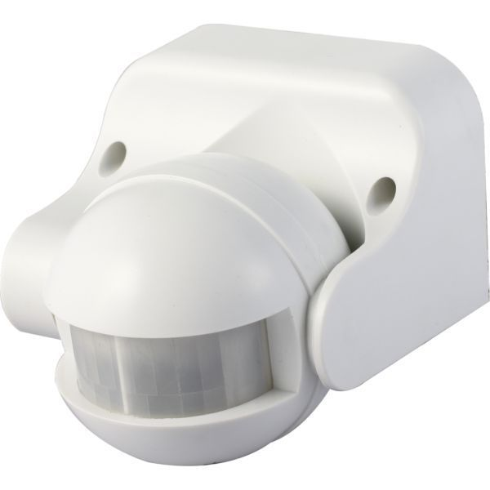
Conclusion
PIR sensors are an important technology that plays a critical role in many sensing applications. They are versatile, cost-effective, and easy to use, making them an attractive option for a wide range of industries.

Slide 10
Questions
What is a PIR device?
Name two products that use PIR detectors
How does a PIR device work?
Why can’t a PIR device detect a plane flying overhead?
Give one example how a PIR detector can save energy
Explain how Passive infrared detectors can be used in cars
State two advantages of Passive infrared detectors
State one limitation of a PIR device

